Slide 1
Major Project – MCA491P
Enhanced LongRange Location Tracking and Fall Detection System
1RV23MC039
RAJESHA C U
Under the Guidance
Of
Dr. Deepika K Associate Professor Department of MCA

Slide 2
Agenda
Introduction
Literature Survey
Objectives of the Project Work
Proposed Methodology
Training Details
Work Progress
References

Slide 3
Introduction and Objectives
Introduction
Designed for remote environments (forests, mountains, disaster zones) where cellular/Wi-Fi networks are unavailable or unreliable.
Aims to enhance safety and monitoring of trekkers, rescue teams, or remote personnel.
Implements an offline, low-power communication system using LoRa technology.
Employs a star topology with one central ESP32 node and four remote ESP32 sensor nodes.
Key Features
Fully offline operation – no need for internet or cellular networks
Real-time communication between nodes and central server
Energy-efficient and suitable for prolonged field usage
Robust and scalable system for extreme and isolated terrains

Slide 4
Domain of the Project
1.Wireless Sensor Networks
a star topology for centralized coordination and simplicity in deployment.
LoRa (Long Range Radio) enables low-bandwidth, low-power communication over long distances
2. IoT and Embedded Systems
Each node is built around the ESP32, a powerful microcontroller with Wi-Fi, and GPIO support.
Integration with sensors (BME280 for environment data) and GPS modules ensures accurate monitoring.
3. Location Tracking and Mapping
GPS data from all nodes enables real-time geolocation.
The central node overlays received coordinates on an offline map using raster tiles stored on the SD card.
4. Data Logging and Visualization
JSON-formatted data is stored in the SD card as a local database (data.txt), allowing historical tracking.
The interface displays environmental and positional data for all connected nodes.

Slide 5
Implementation
Module 1: Remote Sensor Node (4 Nodes)
(ESP32 + LoRa + GPS + BME280 + Emergency Button + Battery)
Input
GPS coordinates: latitude, longitude
Environmental data: temperature, pressure, altitude (from BME280)
Battery voltage (via analog pin)
Emergency signal (via push button)
LoRa configuration (433 MHz)
Process
Read sensor data (GPS + BME280).
Read battery level using ADC and calculate percentage.
Detect emergency button press.
Pack all data into a JSON object

Slide 6
Output
LoRa-transmitted JSON data packet to central ESP32.
Emergency alerts (if triggered).
Consistent periodic updates (e.g., every 5 or 10 seconds).
Module 2: Central Gateway Node
(ESP32 + LoRa + SD Card + GPS + Offline Web Server)
Input
LoRa packets from 4 remote nodes (JSON format).
Local GPS data (to locate the gateway).
Pre-stored offline map tiles (from SD card).
data.txt file stored in SD card with logged sensor data.

Slide 7
Process
Parse incoming JSON packets via LoRa.
Append new data to data.txt in SD card.
Extract location (lat, lon) from each node.
Serve HTML/JS web interface via ESP32 soft AP.
Display markers on the offline map (Leaflet + MBTiles).
Allow visualization of current data per node in UI.
Color markers if battery is low or alert is triggered.
Output
Web-based dashboard showing:
Live location of all nodes.
Environmental readings.
Battery levels and alert indicators.
Stored data.txt file containing all received data.

Slide 8
Module 3: Data Logging to SD Card
Input
Received JSON data (LoRa).
Existing data file on SD card (data.txt).
Process
Mount SD card using SPI.
Open file in append mode.
Write JSON string as a new line.
Ensure no overwrite or corruption using checks.
Output
All JSON data is saved to data.txt:

Slide 9
Module 4: Offline Map Rendering (Leaflet + Map Tiles)
Input
Map tiles stored in SD card (e.g., /map/12/2234/1445.png)
Location data from data.txt
Process
Leaflet JS reads map tiles from SD card directory.
JavaScript parses the stored JSON data.
Extract lat/lon for each node.
Dynamically place markers on the map.
Style markers based on alert and battery status.
Output
Interactive offline map
Shows all node positions with custom icons.
Clicking markers shows sensor data.
Updates when new data is received.

Slide 10
Module 5: Web Dashboard (ESP32 Web Server)
Input
ESP32 AP credentials (SSID, Password)
HTML/JS/CSS files from SD card
Sensor data read from SD card
Process
Serve HTML files via ESPAsyncWebServer
Load map and marker data in JavaScript.
Periodically fetch latest data.txt entries.
Display individual node data in cards or tables.
Output
Fully functional offline dashboard accessible via mobile:
Map with markers
Node list with temperature, pressure, battery
Alerts and warning messages if battery is low or emergency is triggered

Slide 11
Testing
Module 1: Remote Sensor Node
Test Case_ID | Feature Tested | Sample Input | Expected Output | Actual Output | Remarks (Pass/Fail)
TC_RS_01 | GPS and Sensor Reading | GPS + BME280 connected | JSON with lat, lon, temp, alt, press | temp, alt, press JSON string with valid sensor values | Pass
TC_RS_02 | Emergency Alert Trigger | Button Pressed | "alert": true in JSON | "alert": true | Pass
Module 2: Central Gateway Node (LoRa Receiver)
Test Case_ID | Feature Tested | Sample Input | Expected Output | Actual Output | Remarks (Pass/Fail)
TC_CN_01 | Receive LoRa packet | JSON packet from Node 1 | Parsed JSON data | Correct JSON object received | Pass
TC_CN_02 | Invalid Data Packet | Garbled LoRa data | Show error / skip storing | LoRa parse failed | Pass

Slide 12
Module 3: SD Card Logging
Test Case_ID | Feature Tested | Sample Input | Expected Output | Actual Output | Remarks (Pass/Fail)
TC_MAP_01 | SD card not mounted | Try writing data | Show “SD Init Failed” | Error shown in serial | Fail
TC_SD_01 | Write JSON to file | Valid JSON | JSON added to data.txt | Failed to write data/ Blank screen | Fail
Test Case_ID | Feature Tested | Sample Input | Expected Output | Actual Output | Remarks (Pass/Fail)
TC_MAP_01 | SD card not mounted | Try writing data | Show “SD Init Failed” | Error shown in serial | Fail
TC_SD_01 | Write JSON to file | Valid JSON | JSON added to data.txt | Failed to write data/ Blank screen | Fail
Module 4: Offline Map Display
Test Case_ID | Feature Tested | Sample Input | Expected Output | Actual Output | Remarks (Pass/Fail)
TC_MAP_01 | Marker on map | Coordinates in data.txt | Marker shown at correct location | Marker displayed | Pass
TC_MAP_02 | Missing tile | Tile file deleted | Blank map or tile error | Map partially loads | Fail

Slide 13
Module 4: Offline Map Display
Test Case_ID | Feature Tested | Sample Input | Expected Output | Actual Output | Remarks (Pass/Fail)
TC_UI_01 | Page load from ESP32 | Open IP in browser | Load map and UI | Page displays with map and data | Pass
TC_UI_02 | Display UI | UI from sd card | Map with UI | Blank UI | Fail

Slide 14
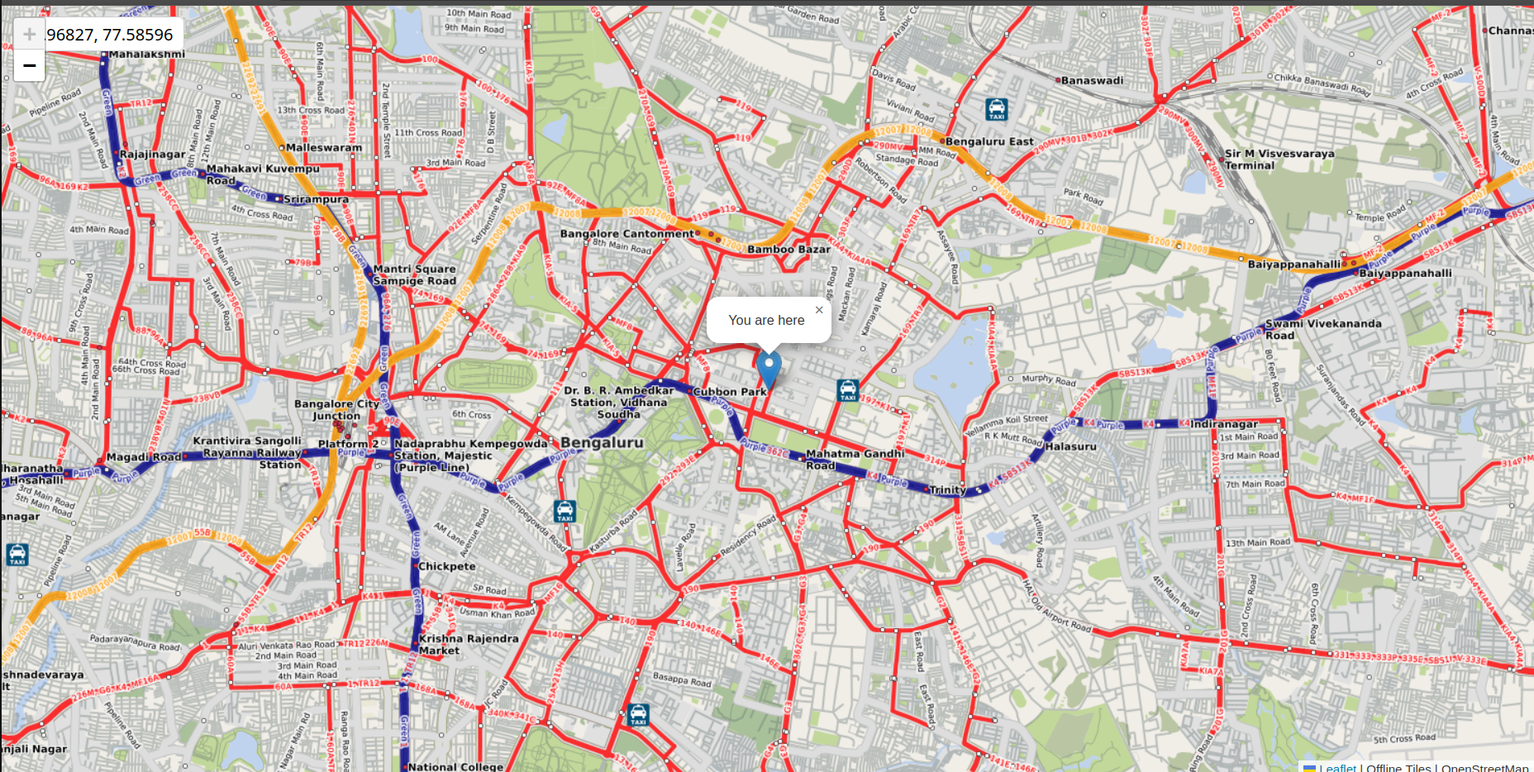
Results
Fig: Map UI display

Slide 15
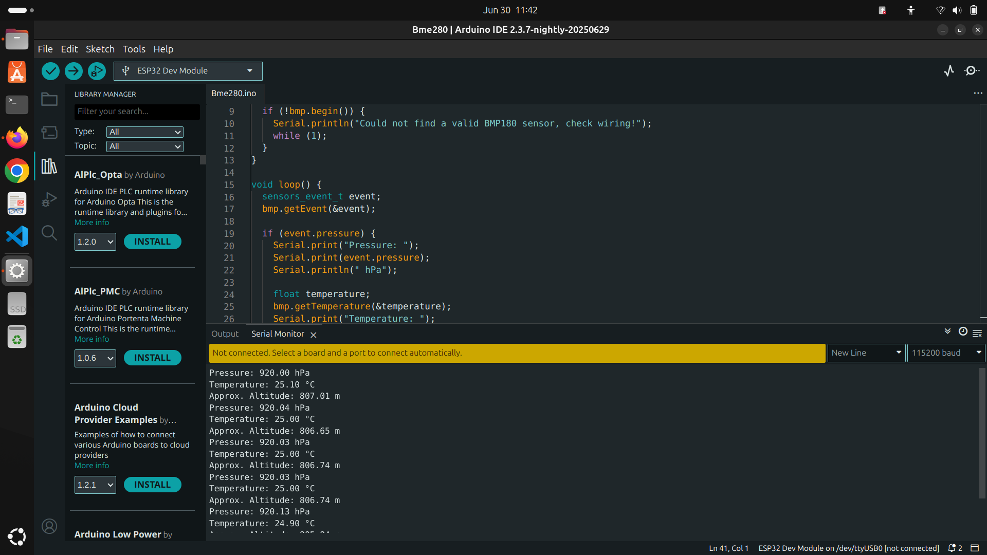
Screen shots of Results
Fig: Sensor Data in serial monitor

Slide 16
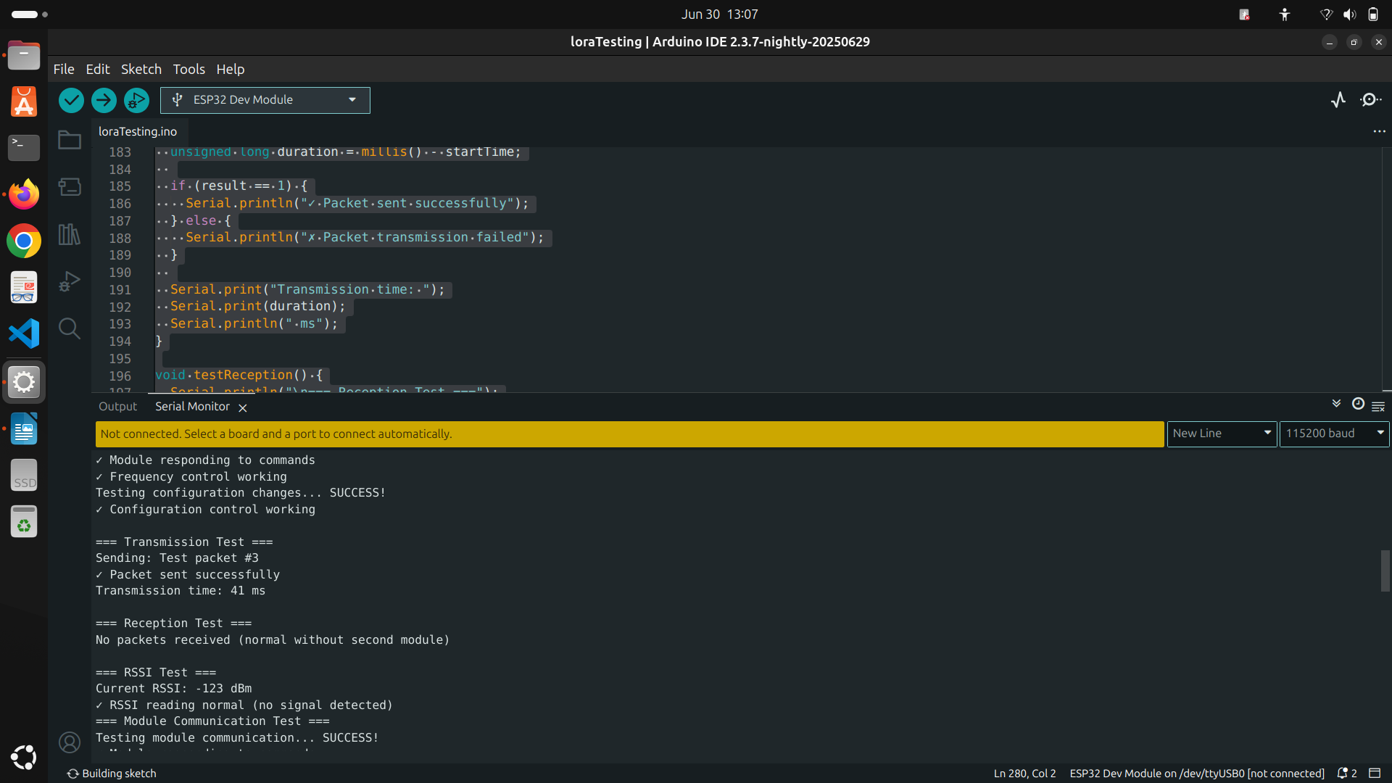
Fig: Packet sending via LoRa

Slide 17
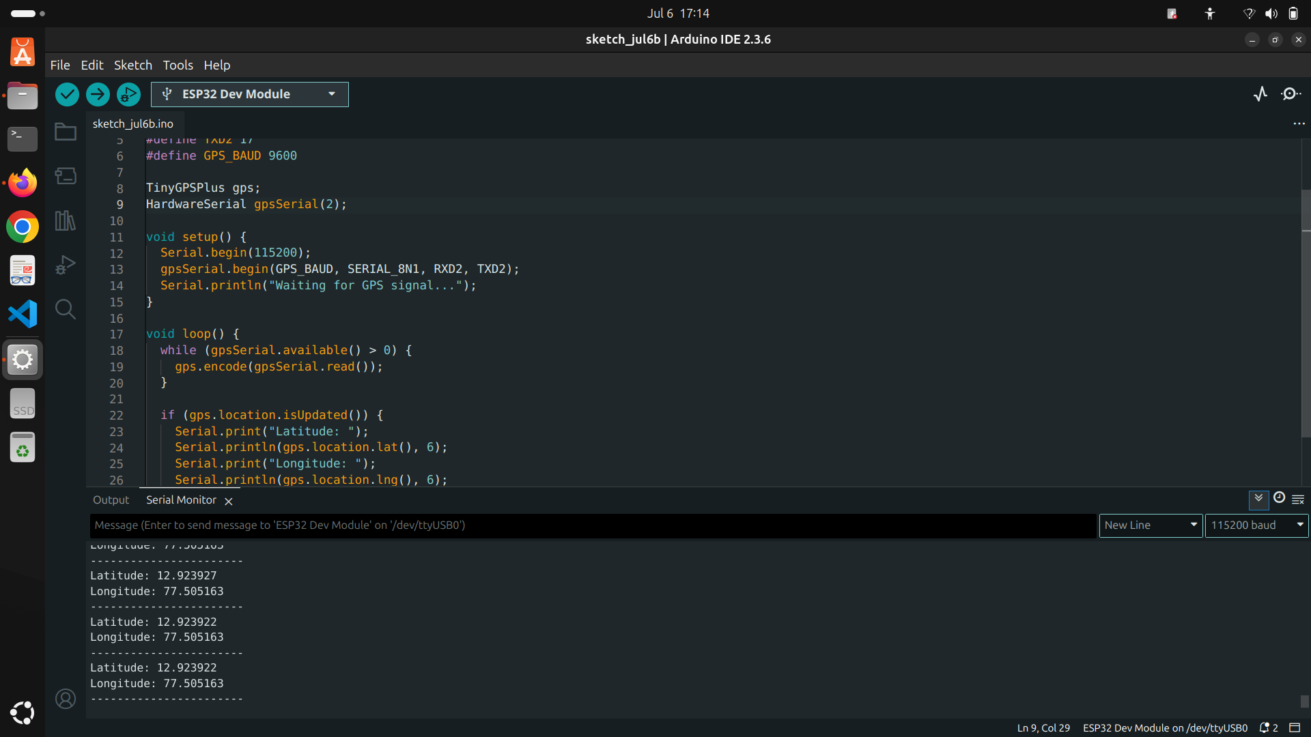
Fig: GPS data in serial Monitor

Slide 18
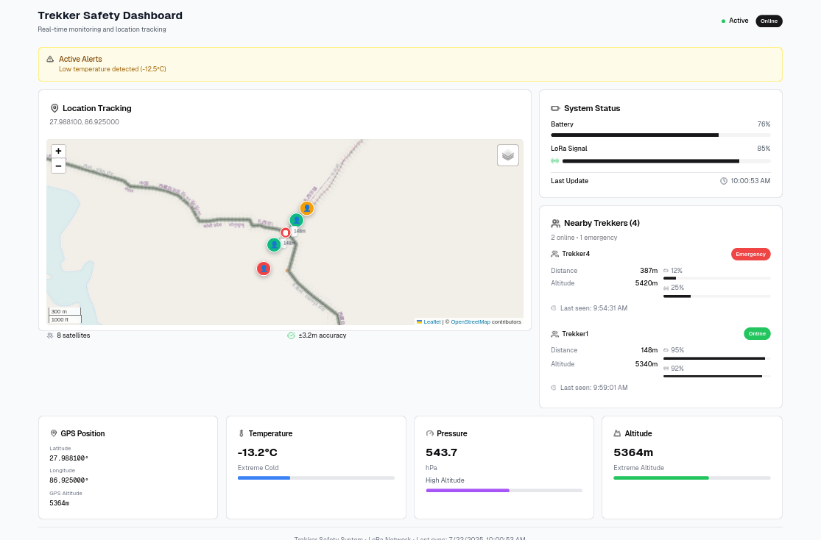
Fig: Front End UI Display

Slide 19
Conclusion
Reliable Wireless Communication
Accurate Environmental Monitoring
Real-Time Emergency Alerts
Efficient Data Logging
Offline Map Integration
User-Friendly Dashboard
Fully Offline Functionality

Slide 20
Future Enhancements
Mesh topology support
Mobile app with Bluetooth data sync
Graphical analytics and trend visualization
Voice/sound-based emergency alert integration

Slide 21
References
1] C. Wu et al., "Ultra-Low-Power LoRa Mesh Networks for Wilderness Tracking," IEEE Transactions on Wireless Communications, vol. 24, no. 3, pp. 45-58, 2025.
[2] A. Khan and B. Li, "Adaptive GPS-LoRa Hybrid Positioning for Remote Areas," IEEE Internet of Things Journal, vol. 12, no. 1, pp. 112-125, 2024.
[3] E. Rodriguez et al., "Energy-Efficient Emergency Alert Systems Using ESP32," IEEE Sensors Journal, vol. 23, no. 8, pp. 210-223, 2024.
[4] G. Park and H. Kim, "Decentralized Tracking in Mountainous Terrain: A LoRa Case Study," IEEE Communications Letters, vol. 27, no. 5, pp. 78-91, 2023.
[5] I. Petrov and J. Silva, "Edge Computing for Real-Time Wilderness Safety Monitoring," IEEE Access, vol. 11, pp. 345-360, 2023.
[6] M. Tanaka and S. Chen, "Battery Optimization Techniques for IoT Tracking Devices," IEEE Transactions on Power Electronics, vol. 38, no. 4, pp. 201-215, 2022.
[7] R. Kumar and P. Sharma, "LoRa-Based Communication Challenges in Himalayan Regions," IEEE Wireless Communications Letters, vol. 10, no. 6, pp. 132-145, 2022.
[8] S. Desai and L. Prakash, "Comparative Analysis of Trekker Safety Systems," IEEE Consumer Electronics Magazine, vol. 11, no. 2, pp. 67-79, 2022.
[9] T. Nguyen and V. Patel, "Low-Power Sensor Fusion for Wilderness Tracking," IEEE Sensors Journal, vol. 21, no. 9, pp. 89-102, 2021.
[10] W. Zhang and X. Liu, "IoT Architectures for Remote Area Monitoring," IEEE Internet of Things Journal, vol. 8, no. 5, pp. 156-170, 2021.

